Slide 1

DEVELOPMENT
OF
BUILDING AUTOMATION SYSTEM
PROTOTYPE
T.V.VIGNESH
Reg. 100906133
4th Year, B.Tech Student
Dept. of E&E,
MIT MANIPAL
GAURAV ANAND
Reg. 100906537
4th Year, B.Tech Student
Dept. of E&E,
MIT MANIPAL
Mr. Vedavyasa Kamath
Assistant Professor
Dept. of E&E,
MIT MANIPAL

Slide 2

AN OUTLINE
Introduction
Core Objectives & Progress
Methodology
Block Diagram
Software/Hardware details
Expected Outcome
Conclusion
References

Slide 3

INTRODUCTION
Building Automation Systems
Power System & Power Electronic Devices
Devices which are to be automated

Slide 4
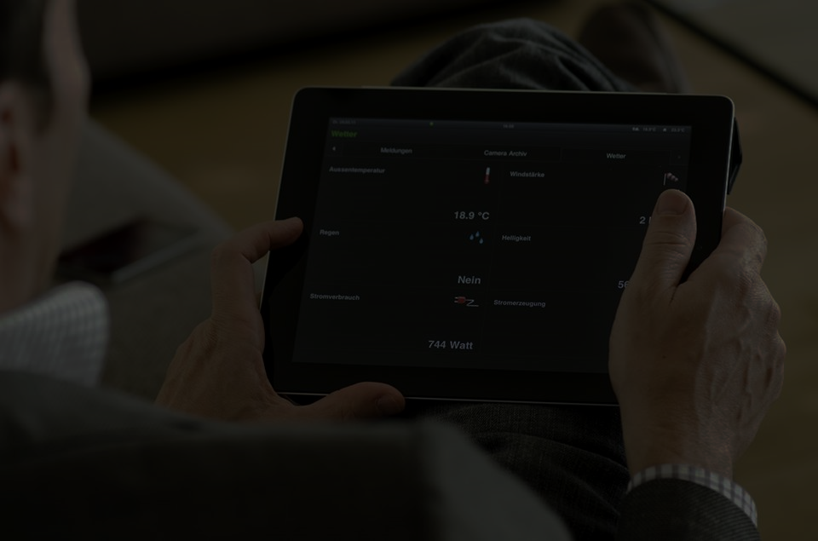
CORE OBJECTIVES AND PROGRESS
CONTROL ELECTRICAL & ELECTRONIC DEVICES
SENSING PARAMETERS OF THE SYSTEM & SURROUNDINGS
AUTOMATE SENSING & CONTROL
ENABLE FLEXIBLE ACCESS OF THE USER INTERFACE
AVOID LOSSES & IMPROVE EFFICIENCY
MONITOR POWER CONSUMPTION AND LOSSES
CREATING A COMMERCIALLY VIABLE SYSTEM

Slide 5

THE MICROPROCESSOR AND MICROCONTROLLER

Slide 6

METHODOLOGY PLANNED
RASPBERRY PI
POWER SYSTEM
ACTUATORS
USER INTERFACE
CHANNEL
POWER SUPPLY

Slide 7
METHODOLOGY IMPLEMENTED
RASPBERRY PI
POWER SYSTEM
ACTUATORS
USER INTERFACE
CHANNEL
POWER SUPPLY
ARDUINO SUBSTATION

Slide 8
CHANNEL
RF (NRF24L01+) AND Wi-Fi

Slide 9

BLOCK DIAGRAM
INTERNET CHANNEL
INDIRECT I/O
I/O INTERFACE
(DIRECT ACCESS)
CENTRALIZED
MICROPROCESSOR
(RASPBERRY PI)
Supporting Supply
RF CHANNEL
Sensors
Arduino Substation
Actuators
Plant

Slide 10
BLOCK DIAGRAM
Internet
Lighting
Security
Fire Safety
Audio/Video
HVAC
Central Control Panel

Slide 11
LIGHTING
USER INTERFACE
ARDUINO SUBSTATION
CHANNEL - RF
RASPBERRY PI 2 BASE STATION
CHANNEL - INTERNET
PWM OUTPUT ADJUSTED BY P CONTROLLER
AMPLIFICATION AND FILTER CIRCUITS
DIGITAL BALLAST
LIGHT FIXTURE
LIGHT SENSOR

Slide 12
SWITCHING DEVICES
USER INTERFACE
ARDUINO SUBSTATION
CHANNEL - RF
RASPBERRY PI 2 BASE STATION
CHANNEL - INTERNET
GPIO OUTPUT
ELECTRONIC RELAY
POWER SYSTEM DEVICE

Slide 13
POWER SUPPLY CONVERSION
220V AC MAINS
AMPLIFIER SUPPLY
TWO LM7812 VOLTAGE REGULATORS
BRIDGE RECTIFIER
12V AC STEP DOWN TRANSFORMER

Slide 14
RF COMMUNICATION
USER INTERFACE
ARDUINO SUBSTATION
RF TRANSCEIVER (PI SIDE)
RASPBERRY PI 2 BASE STATION
CHANNEL - INTERNET
GPIO OUTPUT
RF TRANSCEIVER (ARDUINO SIDE)

Slide 15
MOTION SENSING (PIR SENSOR)

Slide 16
DOOR SENSING (REED RELAY)

Slide 17
TEMPERATURE SENSING (LM35,DHT11)

Slide 18
HUMIDITY SENSING (DHT11)

Slide 19
SWITCHING DEVICES

Slide 20
PROBLEMS ENCOUNTERED AND CORRECTIVE STEPS TAKEN
BURNT RASPBERRY PI
BURNT RELAY
DRIVER CONFIGURATION
DEVICE HUNT
SHOCK
MESSED UP WIRING
NOISE IN AMPLIFICATION CIRCUIT
NON FUNCTIONAL DEVICES

Slide 21
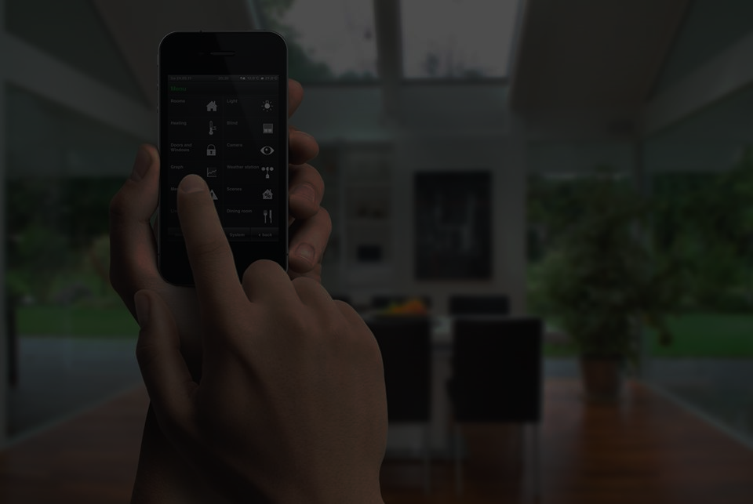
HARDWARE DETAILS
Raspberry PI 2 Model B
&
ARDUINO
Connectors & Board
Wi-Fi Dongle & Xbee
SENSORS
RESISTORS
CAPACITORS
TRANSISTORS
RELAYS
RECTIFIERS & ACTUATORS
ADC
STEP DOWN TRANSFORMER
I/O DISPLAY
DIODES
DC-DC BOOST CONVERTER
DC POWER SUPPLY

Slide 22
HARDWARE DETAILS
SENSORS
Light
Temperature
Smoke
Motion
Humidity

Slide 23

SOFTWARE DETAILS
HTML
CSS
JAVASCRIPT & JQUERY
PHP
MySQL
PYTHON
LINUX SHELL
ADOBE PHONEGAP
C++

Slide 24
EXPECTED OUTCOME BY END SEMESTER

Slide 25

CONCLUSION
http://tinyurl.com/mybas

Slide 26

THANK YOU…
ANY QUESTIONS?

